Slide 1
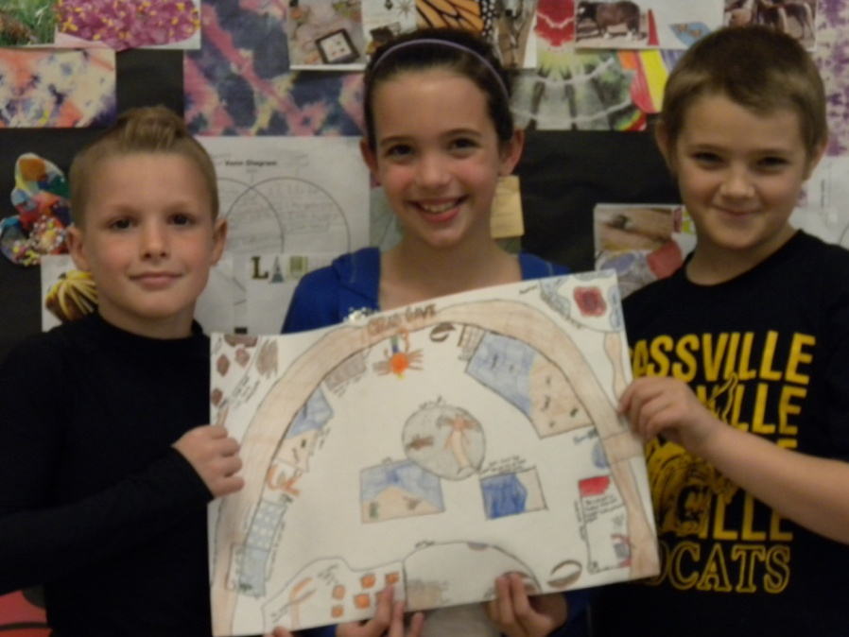
Crab Cave
By: Nathan, Madry ,and Matthew

Slide 2
Our Exhibit
Welcome! Let’s go into the world of Fiddler Crabs! Come on let’s go look around. Are you ready to take an adventure in to the Crab Cave? When you first come in you will be able to play, hold, and feed a Fiddler Crab, buy a poster and get one free, buy a Fiddler Crab build a habitat and take it home, go to the Kid’s Learning Center, and look at the body parts of the crab. When you play, feed, and hold a Fiddler Crab you have to pay 50 cents. When you get a poster you have to pay $1.00. When you build a habitat you have to pay $2.00 and you can get instructions for the habitat.

Slide 3
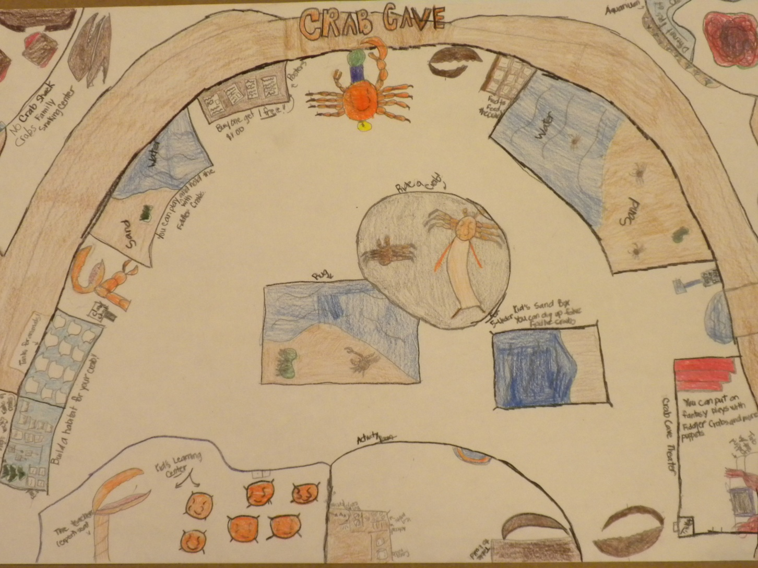
Crab Cave

Slide 4
Our Exhibit
You can also visit the Crab Shack if you’re hungry, and you can visit the Crab Cave Theater ,visit the Aquarium and look at all the different crabs, then you can ride a censer crab and go down the slide, you can dig up a fake Fiddler Crab. In the theater there are lines to say that give information. You can get the tickets for the theater at the entrence. The theater is a puppet theater where you can put on puppet shows.
Puppets: Fiddler Crabs and more.

Slide 5
Our Exhibit
The kids will learn about Fiddlers Crabs and their Natural Habitat- Their natural habitat is brackish water, sandy beaches, and mud flats.
Male and female Fiddler Crabs are different- The male has 1 large claw. The female has 2 equal sized claws. The male uses his big claw to attract females.
They are small- They can grow up to 3 inches long.
They will need food, shelter and water to survive in a home or classroom.- They will need brackish water; plant mater; bacteria/ and algae; shrimp; warm weather; sand; mud; and a clean tank.

Slide 6
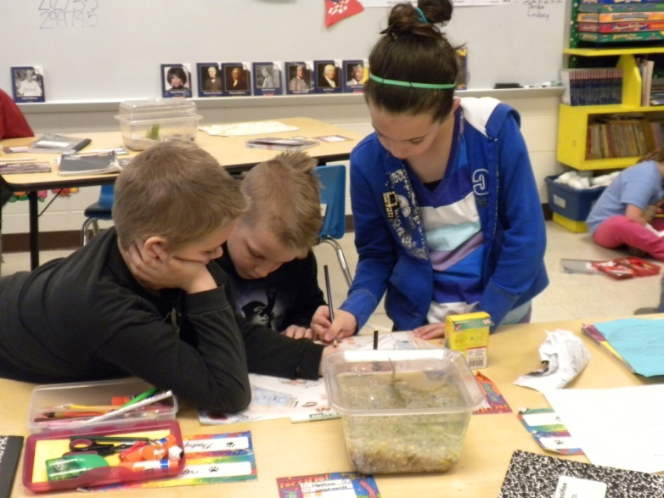
Our Exhibit
We want you to pick our exhibit because it is hands on, it is fun and very entertaining at the same time, you also learn tons of interesting facts. All the things we have will blow your mind. That is why we want you to pick our exhibit.

