Slide 1
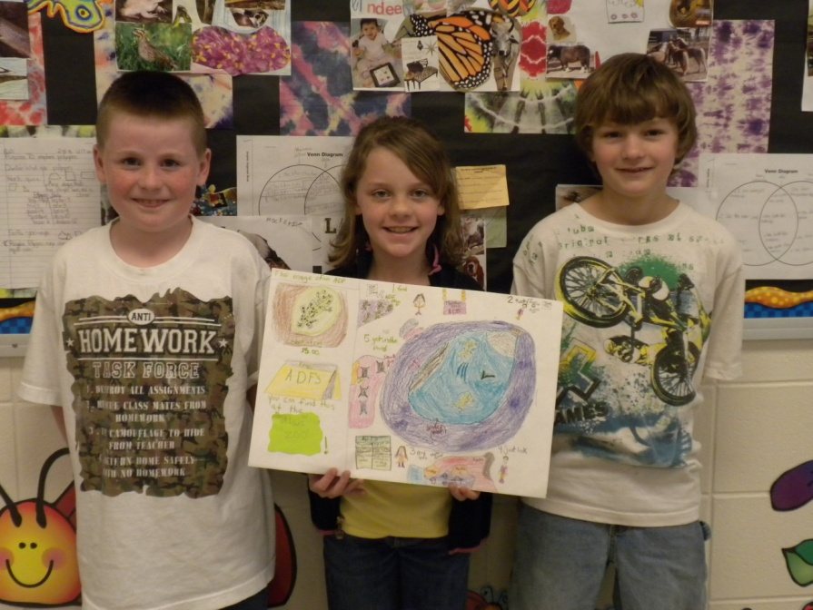
The Magic Of An African Dwarf Frog
By: Grady ,Carson , and Gabrielle

Slide 2
Our Exhibit
“Welcome To The Magic Of An African Dwarf Frog.” First ,the kids will learn what the African dwarf frogs eat. They eat blood worms, brine shrimp, water fleas, shrimp. The kids will learn how to draw an African Dwarf Frog . Things they will find at the zoo is there habitat. Pillows that look like African Dwarf Frogs.

Slide 3
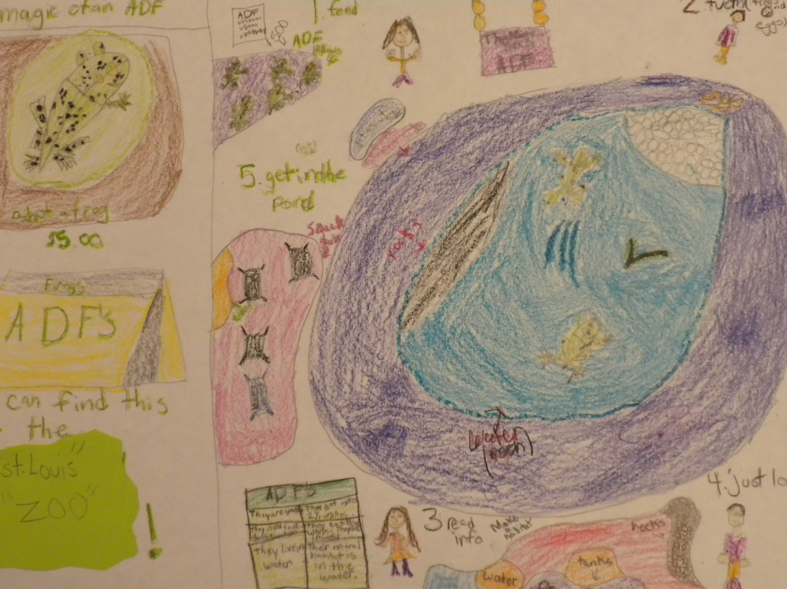
The Magic Of An African Dwarf Frog

Slide 4
Our Exhibit
Next, The kids should learn what an African Dwarf Frog needs to survive. They need water, rocks, and elodea . There natural habitat is in shallow waters, ponds. There temperature needs to be 68 to 84.How to make a habitat is first get the tank ,rocks, water, elodea.

Slide 5
Our Exhibit
Then , the kids will eat lunch then they will learn how to build a habitat for an African dwarf frog .The kids will learn how small they can get up to 2½ inches long .You should not tap the tank or they “die”.

Slide 6
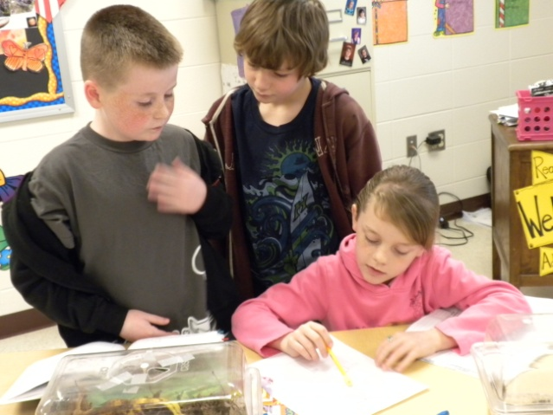
Our Exhibit
Last , We will allow the kids to adopt a frog for $5.00 and get in the pond for the last time and get to play on the African Dwarf Frog playground and buy a pillow for $5.00. You should choose our exhibit because its hands on and children will love it.

